Slide 1


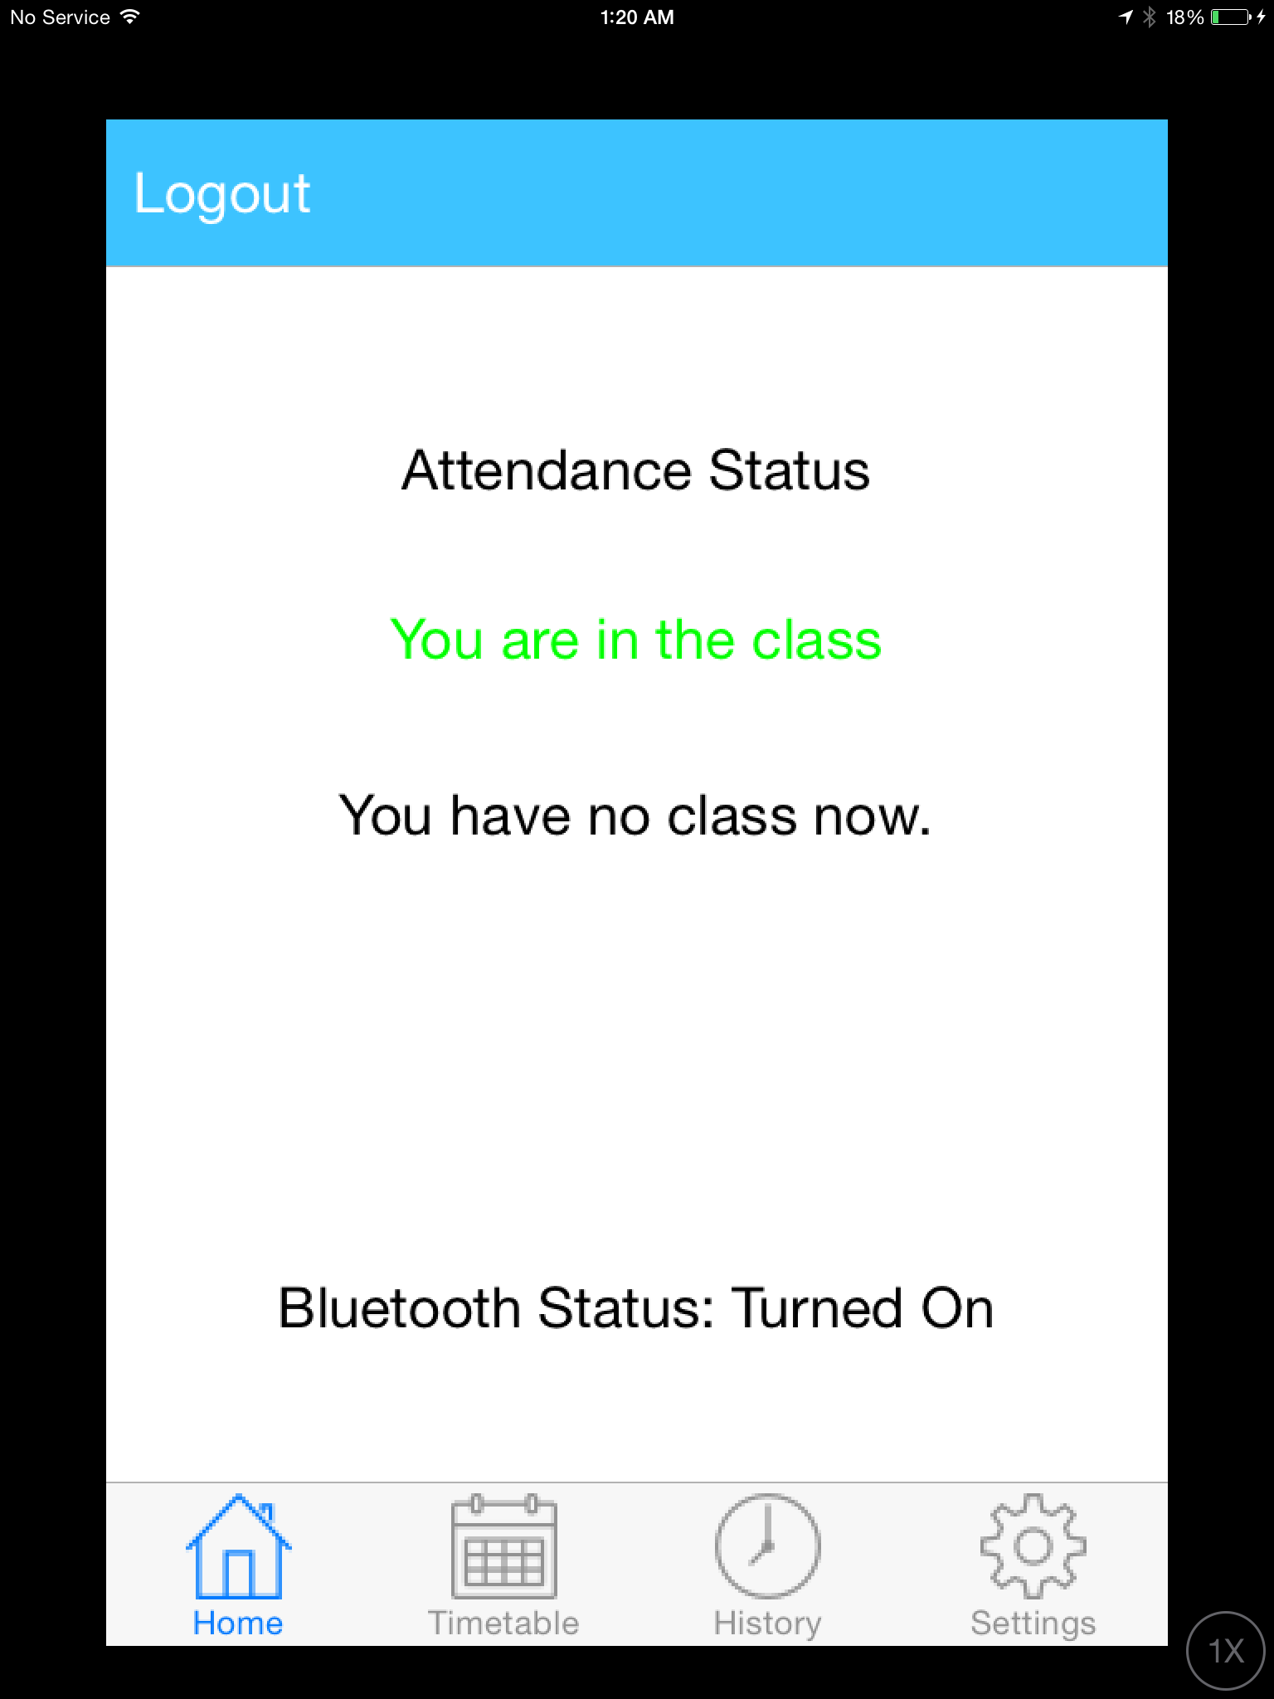
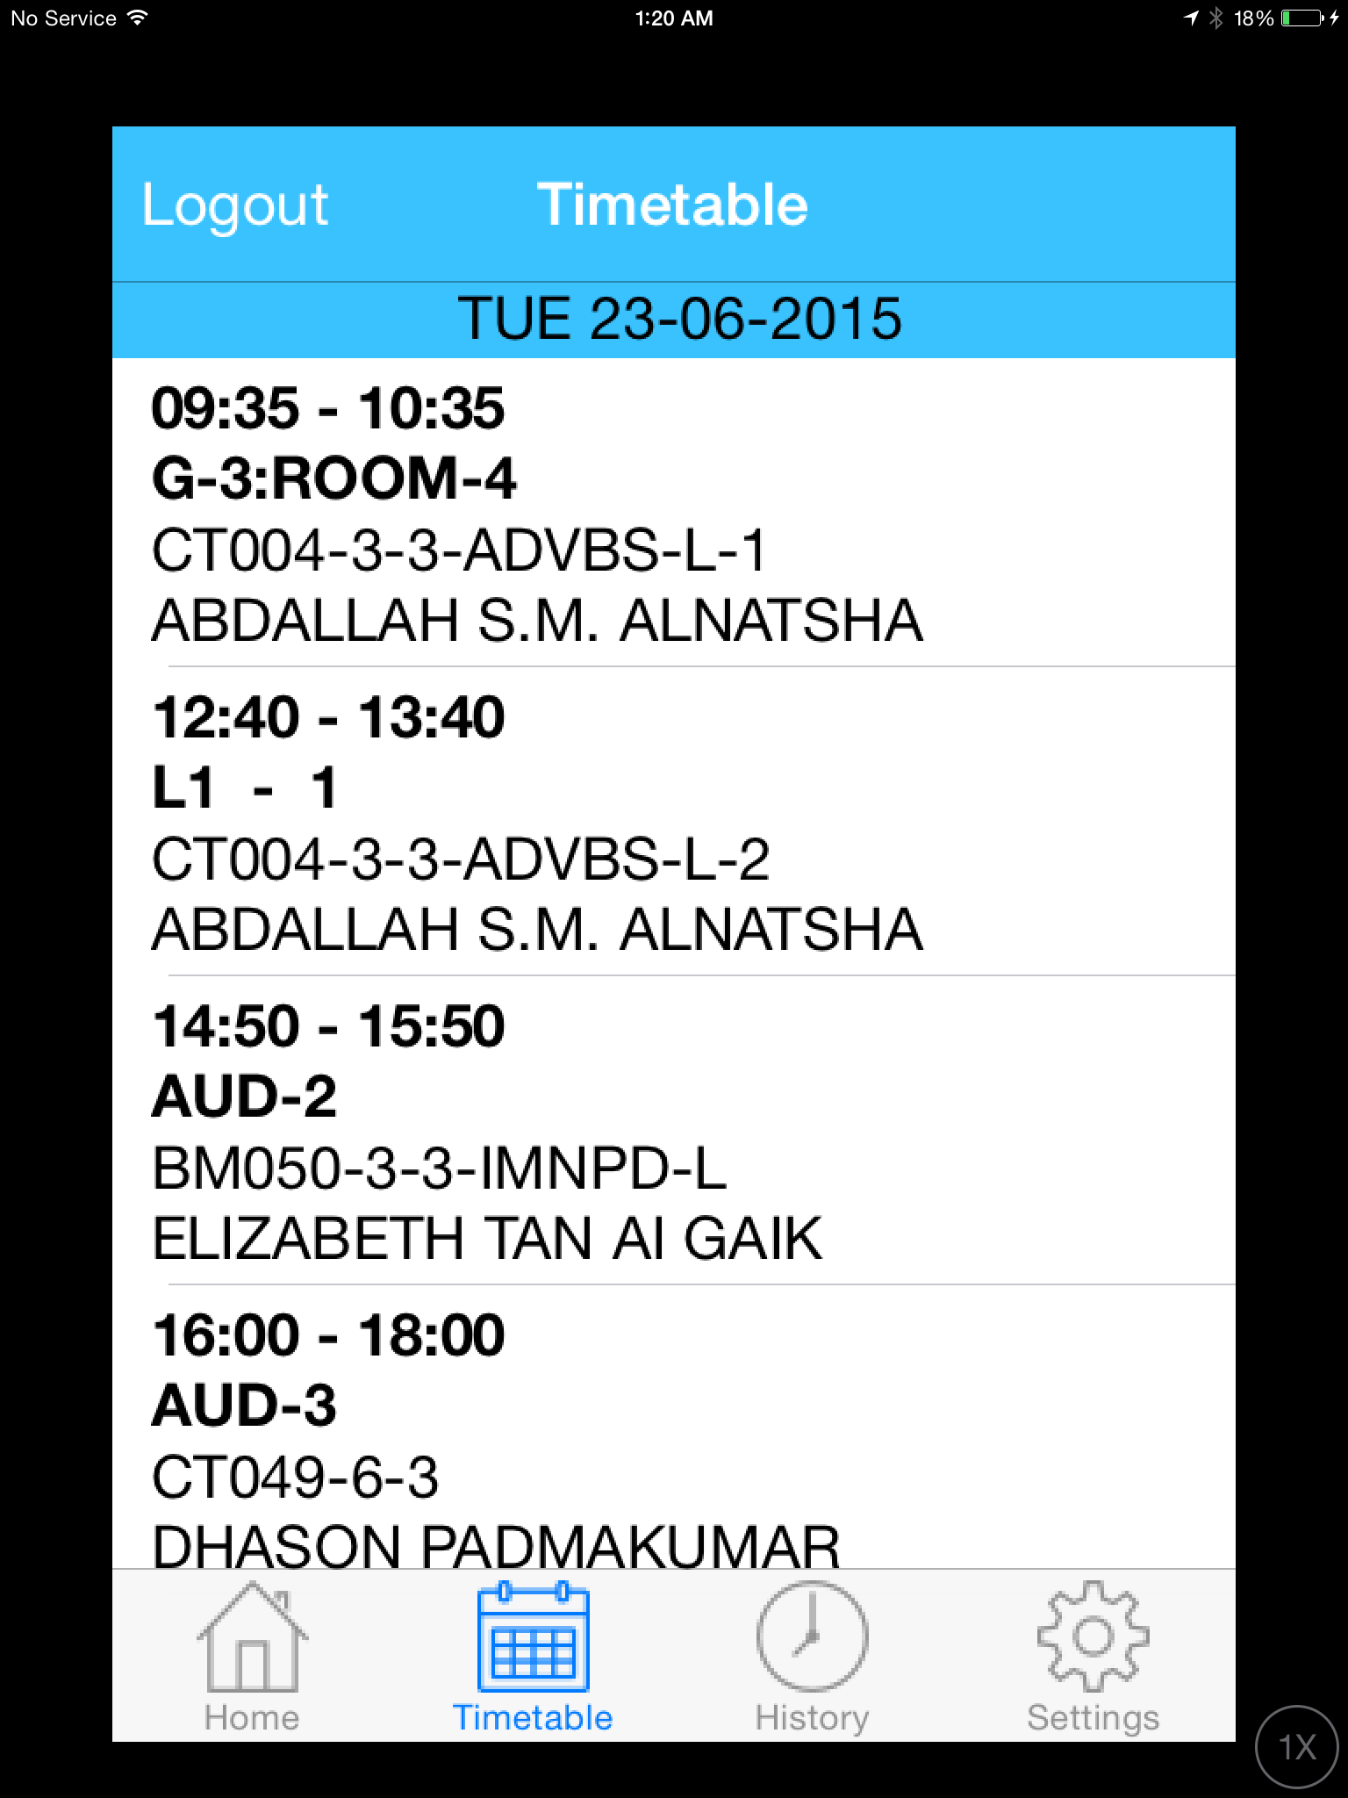


APPTENDANCE
(AUTOMATED MOBILE ATTENDANCE SYSTEM)
Miss/Mr. LEO JIE HUI(TP00000-UC3F2002)
BSc (Hons) in Software Engineering
Supervisor: Mr.David Tan | Second Marker: Miss.Sathiyapriya
Introduction
APPTENDANCE, is an automated mobile attendance system that allows Asia Pacific University to mark attendance by using their smartphone with radio frequency identification. After implemented this system into the University, the lecturer does not need to help students to mark attendance, students can mark attendance with their own by entering into the classroom, then the attendance will be taken automatically.
This automated mobile attendance system is the first automated attendance system with smartphone that has been developed in Malaysia. This is a good approach to develop such a nice system that help to make students and lecturers life more simple.
Technology Used to implement Apptendance
System Feature
User is able to sign up as student
Students take attendance based on their class schedule and intake
Students can view their current intake timetable schedule
Students can check their attendance history
Students can provide feedback and report bug to developer to enhance the system in the future
Apptendance is develop by using the Swift Programming Language and support for iOS platform only. It means that the Apptendance automated mobile attendance system is only available for iPhone and iPad devices.
Objective
Conclusion
To develop an attendance application that is only for student to use it.
To determine the effectiveness of taking attendance without lecturer instead of using Radio Frequency Identification (RFID)
To create several functionalities into application such as take attendance by students themselves and check the attendance history as well as check intake timetable.
By the end of the project, the developer has used 3 months to finish develop the Apptendance automated mobile attendance system. The system is working great as expected by the developer.
The developer hope that the Apptendance automated mobile attendance system could help Asia Pacific University a lot in terms of marking the attendance. By using the Apptendance, the performance to mark for every students is higher compare to the traditional method.
On top of that, the developer hopes that the Asia Pacific University will be use the Apptendance automated mobile attendance system as their core attendance system. This means that all the students in Asia Pacific University is able to use their smartphone to mark attendance very soon. As research by the developer, most of the respondents that took the questionnaire survey is satisfied with the mobile attendance by using the smartphone with radio frequency identification.
Apptendance is the only automated mobile attendance that suitable to use in every college or university so that the students can take their attendance easily.
Screenshot of Attendance Home Page
Screenshot of Timetable Page
Hardware and Software Requirement Specification
Apptendance (Automated Mobile Attendance System)
Developed by: LEO JIE HUI
TP025761
BSc (Hons) in Software Engineering
Intake Code: UC3F1410SE
Supervised by: Dhason Padmakumar
Apptendance automated mobile attendance system is only support for the devices and software version as shown below.
iPhone 4s or above
iPad (3rd generation or above)
iPod touch
It is require the devices installed with iOS 8.0 or later
Not compatible with Android OS, Windows Phone OS and others.

